Slide 1
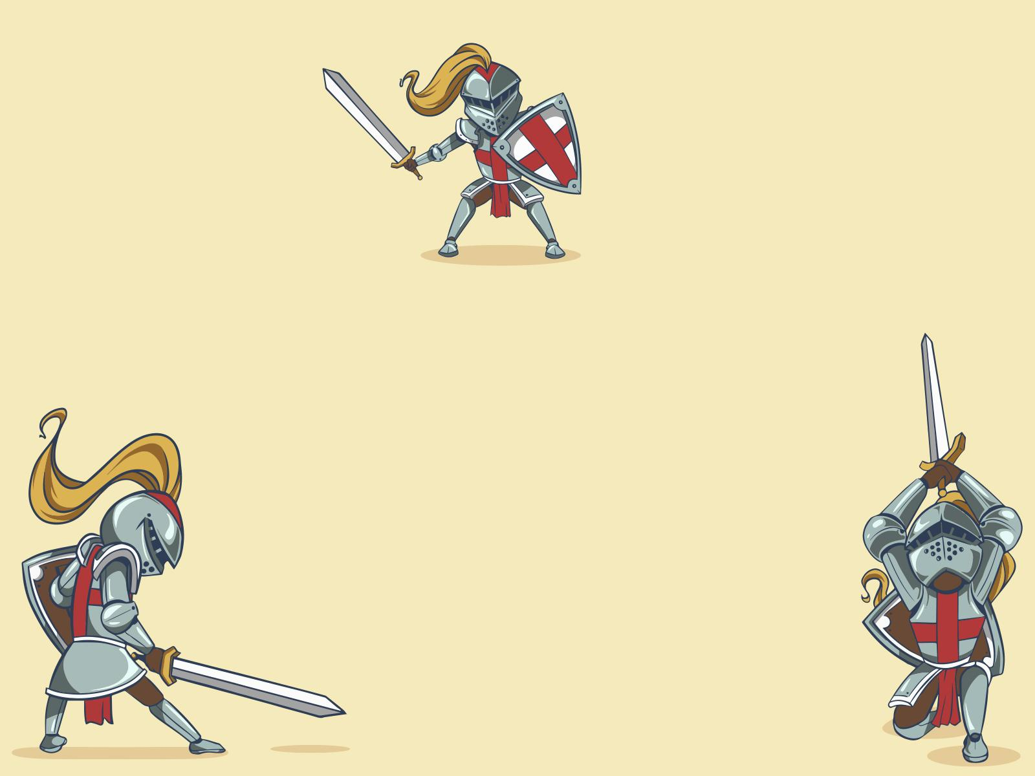
Attack MNIST Recognition
Chaitanya Mehta

Slide 2
What Are Adversarial Attacks?
Adversarial attacks are carefully crafted small perturbations added to input images that are almost invisible to humans
These tiny changes can cause a model to make completely wrong predictions with high confidence
The key idea: maximize model error while keeping the image visually unchanged
This exposes a major weakness in deep learning systems used in real-world applications

Slide 3
FGSM - The Giant Leap
I-FGSM - Careful Climb
MI-FGSM
Iterative FGSM improves FGSM by breaking attack into many small steps
Instead of one big jump, it applies small perturbations repeatedly
Includes a clipping mechanism to ensure the image stays close to the original input
Visual effect: subtle and targeted changes
Main advantage: higher success rate and less visible perturbations
Limitation: slower than FGSM due to multiple computations
FGSM is a single-step white-box attack
Extremely fast and computationally cheap
Computes the gradient of the loss function only once, then updates all pixels simultaneously
The update rule pushes each pixel in the direction that maximally increases the model’s error
Visual effect: often appears as grainy or static-like noise
Limitation: less precise and sometimes more noticeable noise
Momentum Iterative FGSM enhances I-FGSM by adding a momentum term
Instead of relying only on the current gradient, it accumulates past gradients to build direction
Helps the attack avoid local maxima or unstable gradient directions
Produces smoother perturbations that are less noisy and more structured
Visual effect: cleaner and more natural-looking adversarial noise
Notes:
Loss Usage: It computes the gradient of the loss once, takes the sign of that gradient ($+1$ or $-1$), and multiplies it by the step size $\epsilon$.
IFGSM: It recalculates the loss and gradient at every step, allowing the attack to adjust its direction as the image moves further from the ground truth.
MI-FGSM: It averages the current loss gradient with a fraction of the previous gradients, ensuring the new image is pushed in a consistently effective direction.

Slide 4
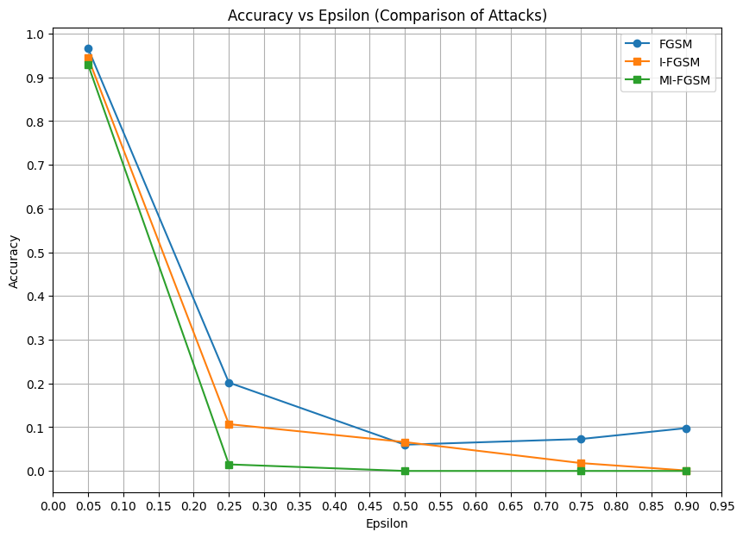
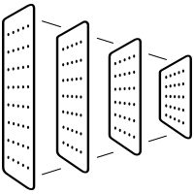
Attack on CNN
Detects patterns like edges and shapes
Understands image structure
Test: 98.6%

Slide 5
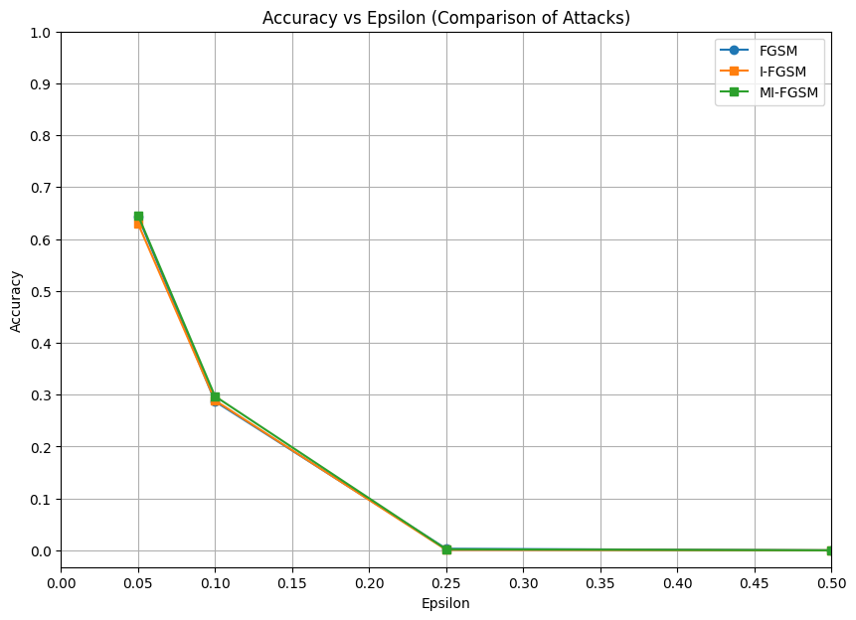
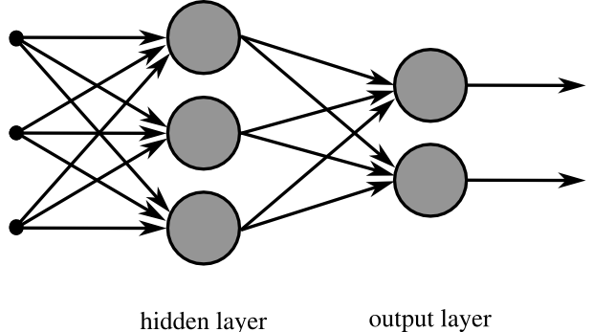
Attack on MLP
Sees image as just numbers
No spatial awareness
Test: 91.5%

